Slide 1

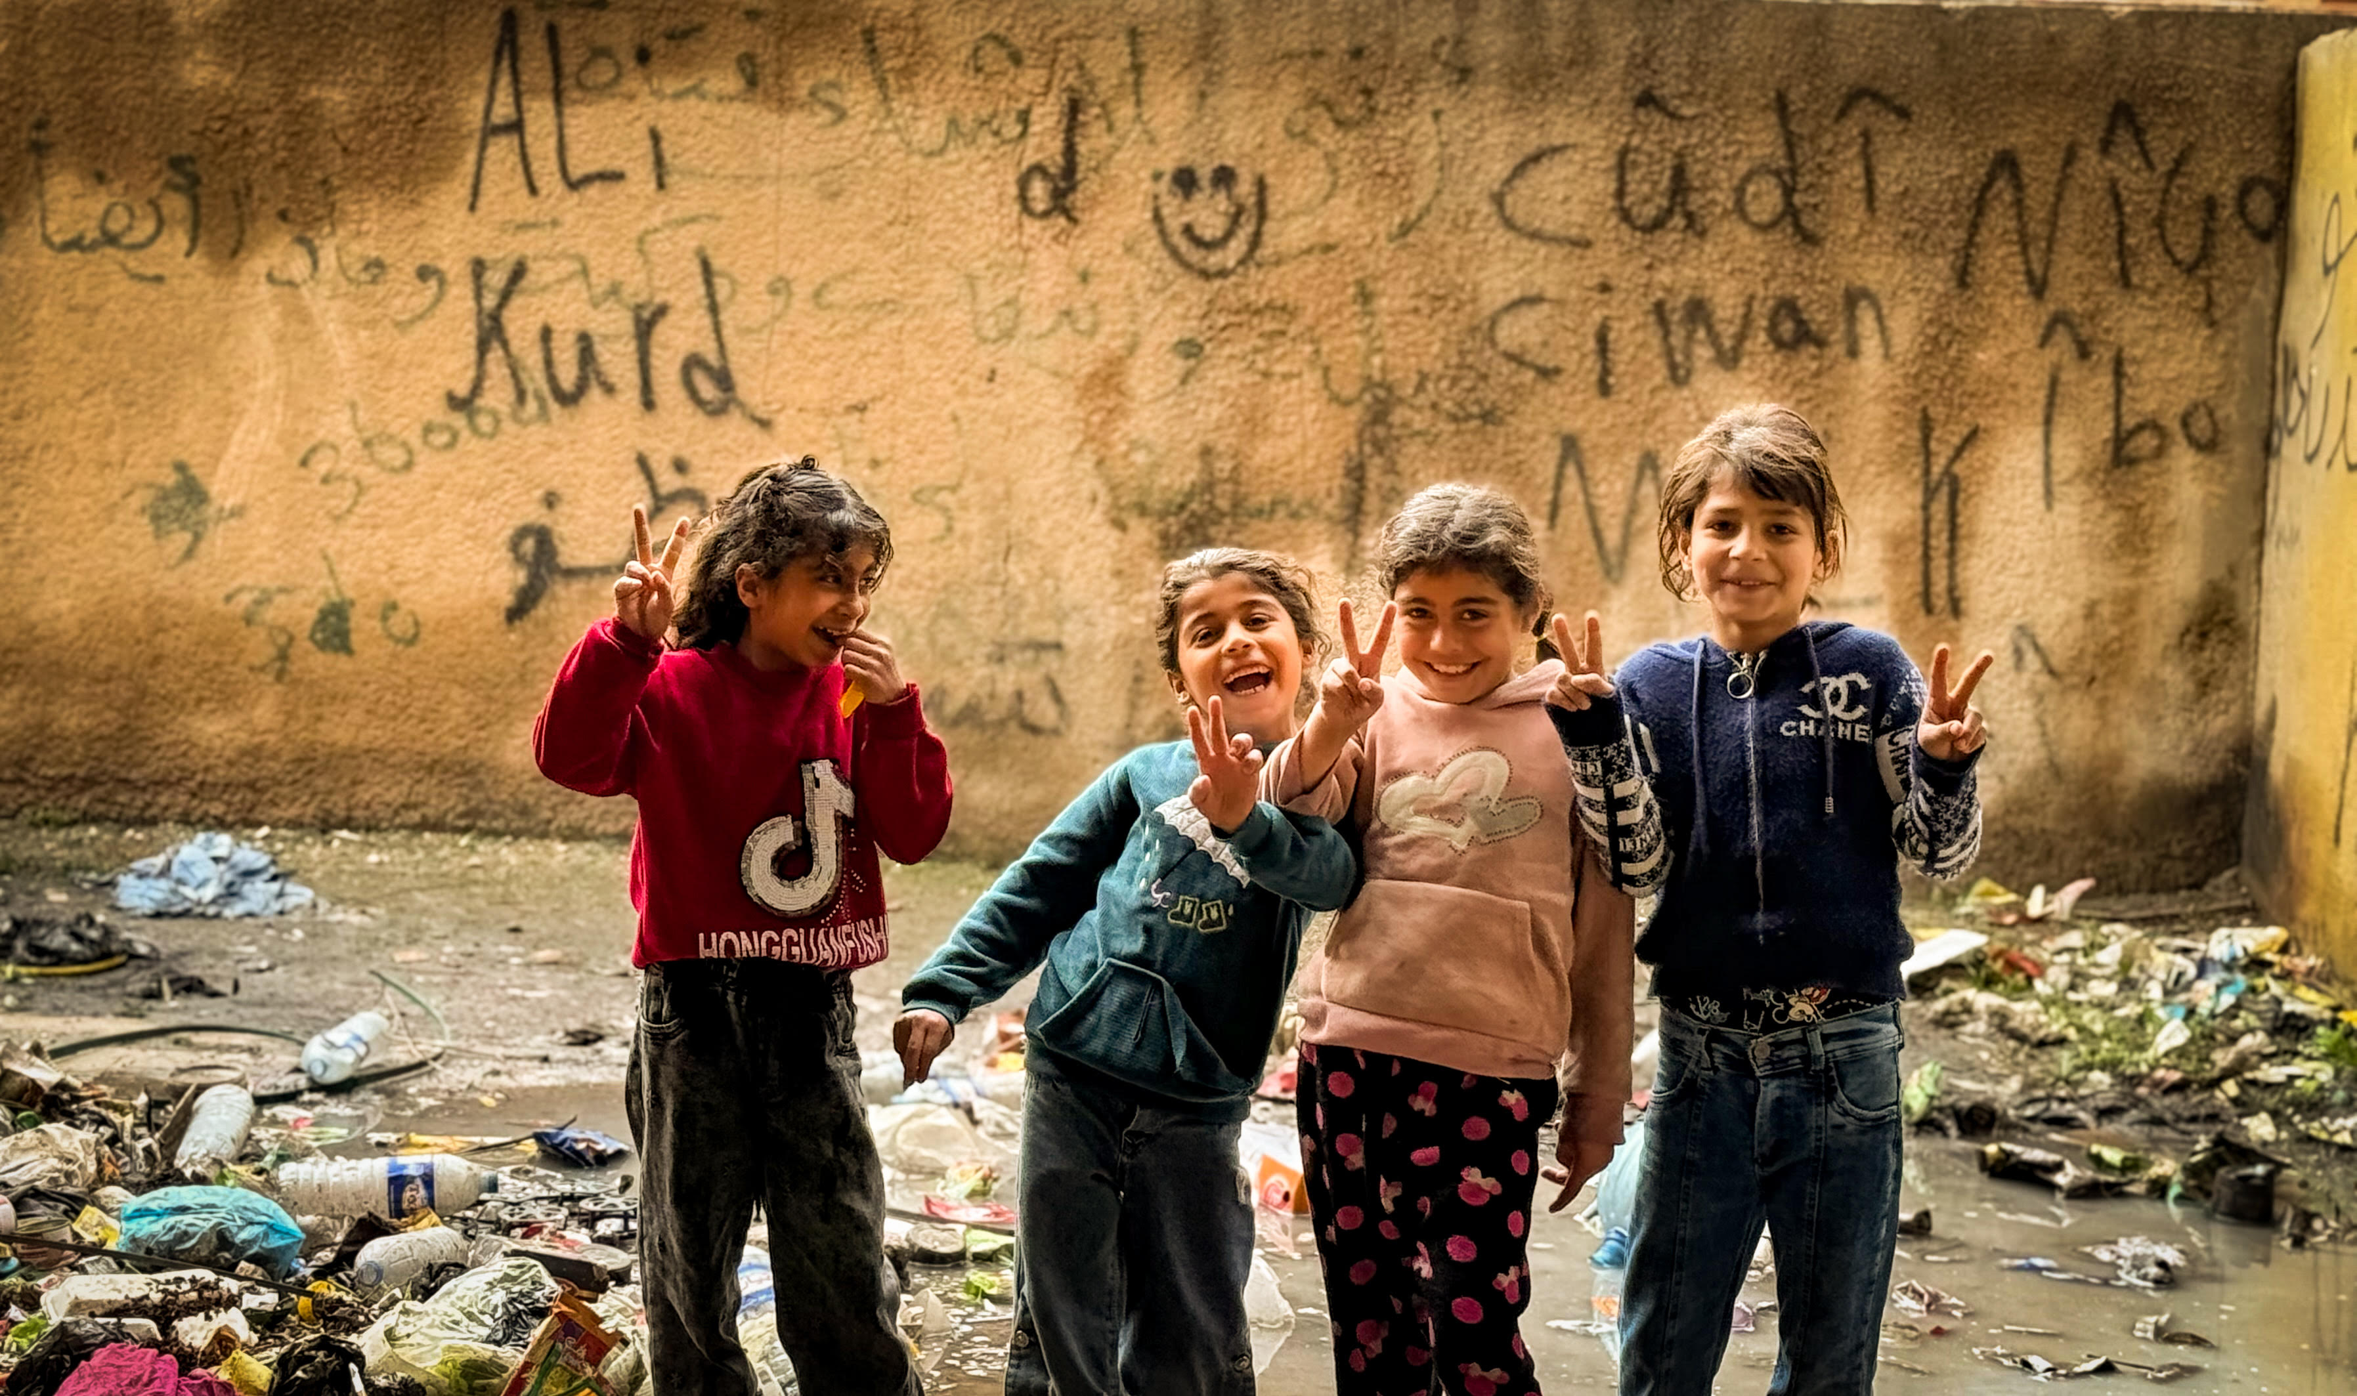

A Prayer for
World Refugee Day
INTERNATIONAL ASSOCIATION FOR REFUGEES •

Slide 2
  God of mercy and peace,
  we come before you with heavy hearts,
  carrying the sorrow of a world marked by war, displacement, and loss.
INTERNATIONAL ASSOCIATION FOR REFUGEES •

Slide 3
  We remember the millions who have lost home, safety, and belonging,
  the families in camps,
  the ones at borders,
  the ones who do not know where they will sleep tonight.
INTERNATIONAL ASSOCIATION FOR REFUGEES •

Slide 4
  God of all people,
  Be near to those walking unknown roads,
  crossing seas, escaping violence,
  searching for a place to live without fear.
INTERNATIONAL ASSOCIATION FOR REFUGEES •

Slide 5
  We pray for this world, O God,
  that hearts may be softened and doors opened,
  that nations may choose compassion over fear.
INTERNATIONAL ASSOCIATION FOR REFUGEES •

Slide 6
  Give us courage to stand with the displaced,
  to welcome the stranger,
  and to act with justice and love.
INTERNATIONAL ASSOCIATION FOR REFUGEES •

Slide 7
  In a time of deep division, teach us what is most difficult:
  to pray even for our enemies,
  and to resist hatred.
  Holy Spirit, transform what is broken in this world, and what is hardened within us.
INTERNATIONAL ASSOCIATION FOR REFUGEES •

Slide 8
  Until the day when no one is forced to flee,
  when every person has a place to belong and every child can grow up in safety,
  keep us faithful, compassionate, and hopeful.
INTERNATIONAL ASSOCIATION FOR REFUGEES • SECTION TITLE HERE

Slide 9
  Jesus, through your mercy, make us instruments of your peace.
  Amen
INTERNATIONAL ASSOCIATION FOR REFUGEES • SECTION TITLE HERE

